Slide 1
Visual Studio and Command Line Tools for ASP.NET 5
Damian Edwards
Principal Program Manager
ASP.NET

Slide 2
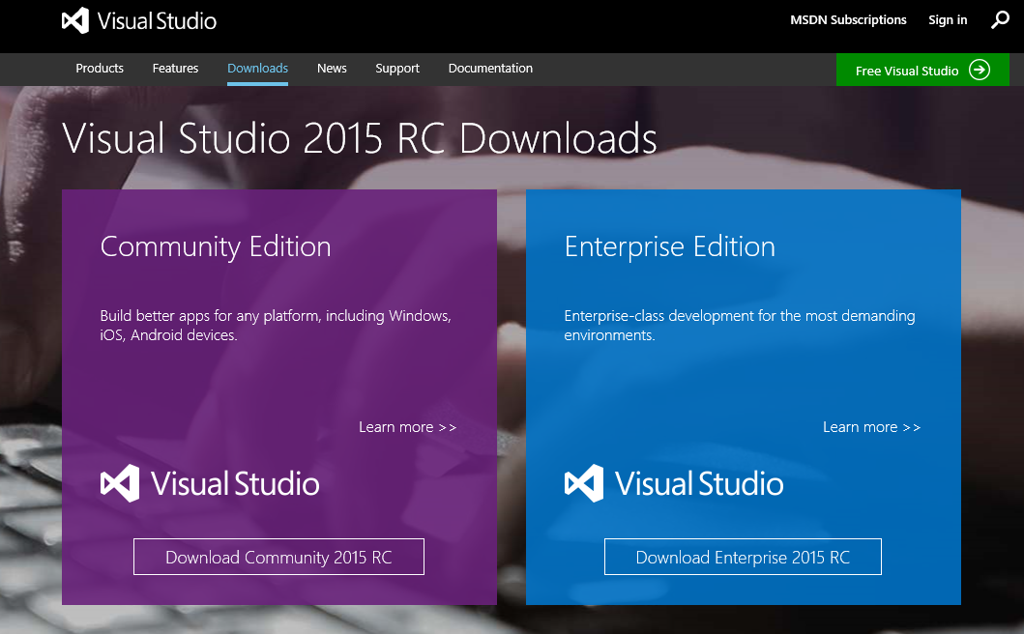
http://visualstudio.com

Slide 3
Demo
Visual Studio 2015 / ASP.NET 5

Slide 4
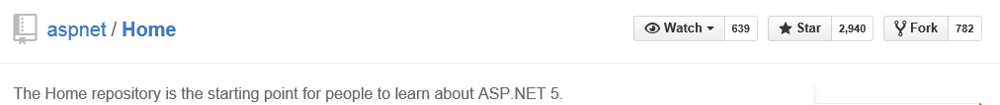
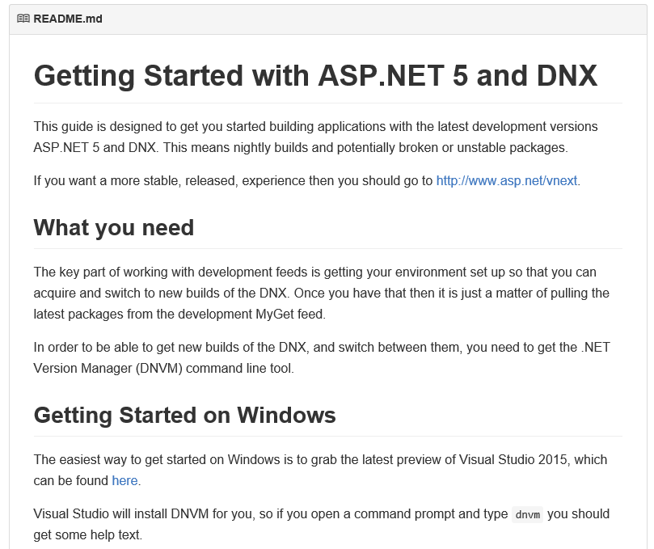
DNX: http://github.com/aspnet/home

Slide 5
Demo
Command Line Tools

